Slide 1

Python Programming

Slide 2




Modules
1
Programming Basics
2
Collections
3 File Operations
4
Functions
5
Visualization

Slide 3
Module 1
Programming Basics (Introduction, Datatypes, Operators, Conditional Statements, Looping Statements)

Slide 4
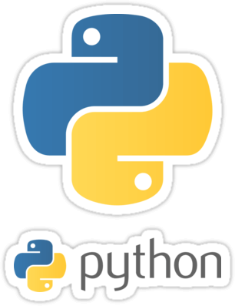
What is Python and Why its popular?
High Level Language - Simple and Easy to learn
Free and Open source
Portable and supports multiple platforms
Supports different programming paradigm
Extensible – Can invoke c, c++ libraries and
integrate with Java & .net components
Growing Popularity

Slide 5








Companies that use Python

Slide 6
Python Applications
01
WEB APPLICATION DEVELOPMENT
02
WEB SCRAPING
03
DESKTOP GUI
04
DATA SCIENCE
05
EDUCATION
06
MACHINE LEARNING
07
ARTIFICIAL INTELLIGENCE
08
NETWORK PROGRAMMING
09
GAMES AND 3D GRAPHICS
10
SUPPORT LANGUAGE - SELENIUM
05
DATABASE ACCESS

Slide 7


Setting up Working Environment
There are two options to install Python:
Barebone Python (Base
Python)
Full blown python distribution
Option 1
Option 2
Specialized Packages
Python Distributions
Anacoda
Canopy
WinPython
Base Python
Specialized Python Distributions

Slide 8
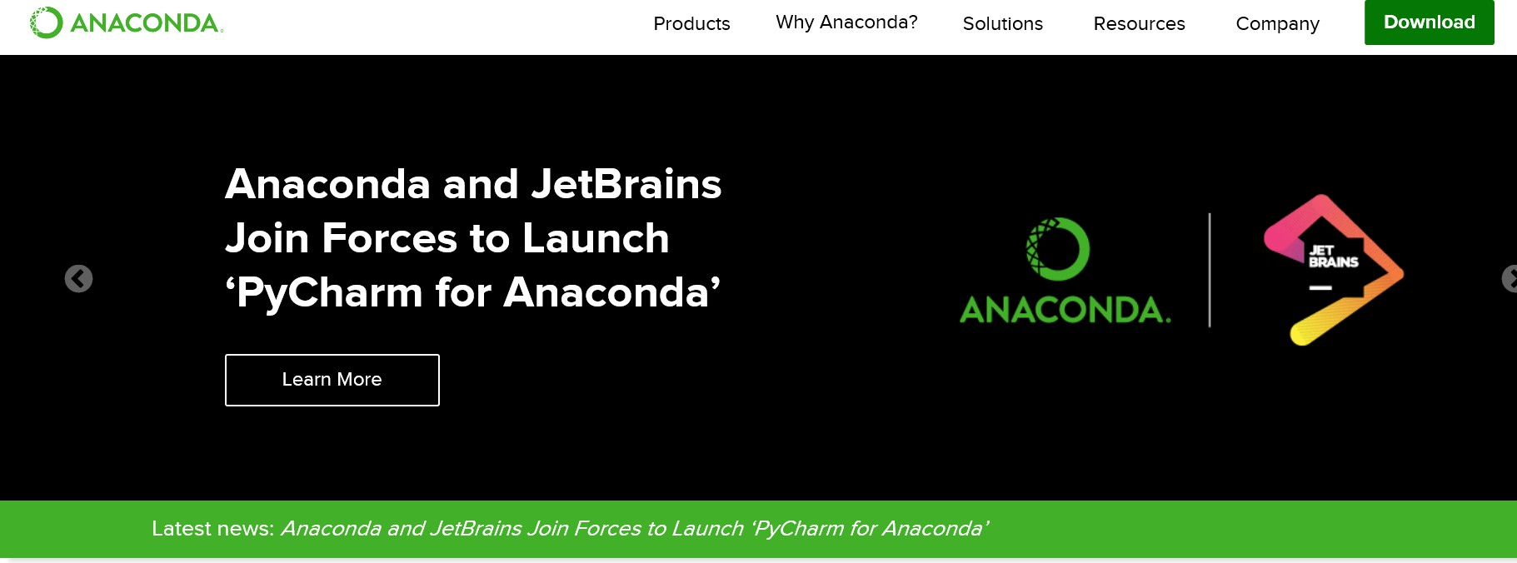
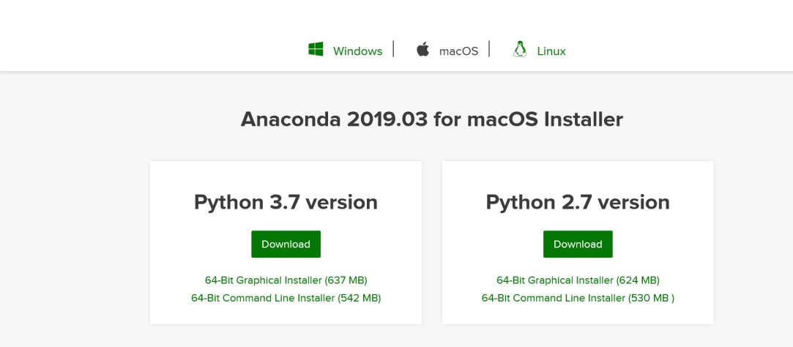
Install Anaconda on Local Machine
Python Essentials
www.anaconda.com

Slide 9

Jupyter Notebook
Open-source web application that allows you to create/execute live code
Run in web browsers
Support 40+ programming languages, including
Python, R, Julia and Scala
Why Name Jupyter?
  Three core programming languages supported by Jupyter – Julia, Python and R

Slide 10
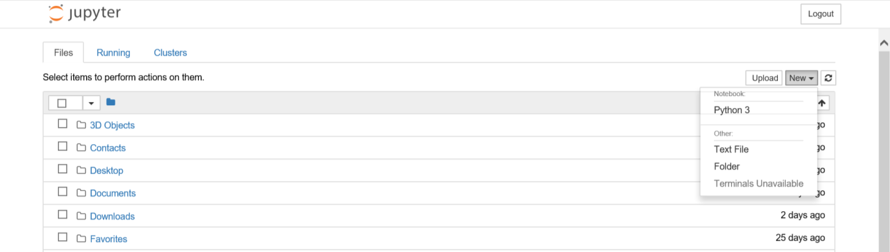
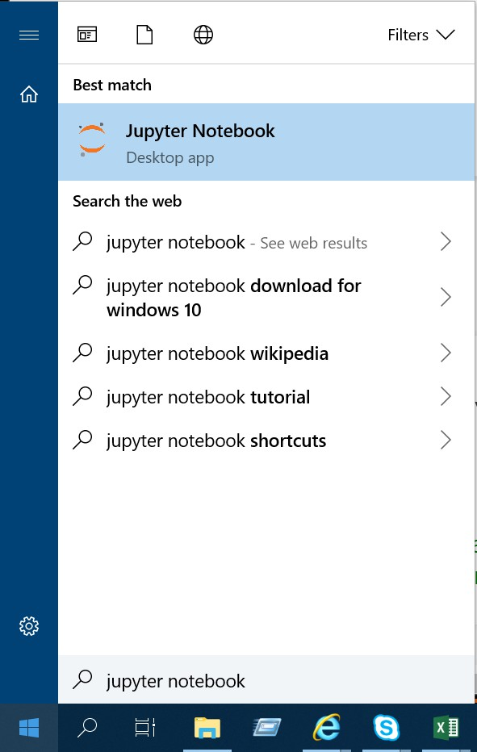
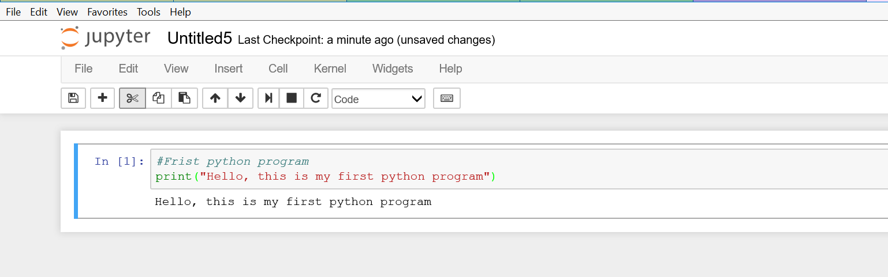
Open/Execute a program in Jupyter Notebook
Step 1 -Type Jupyter Notebook in windows start prompt
Step 2 – choose, python3 from New dropdown box
Step 3 – Write a sample program, and click run cell to run the program

Slide 11
Data types in Python
Number
List
Tuple
String
Set
Dictionary
Refer Programming Basics.ipynb

Slide 12
Datatypes in Python
Numbers
Integers, floating point numbers and complex numbers falls under Python numbers
category.
Strings
String literals in python are surrounded by either single quotation marks, or double quotation marks
  “Hello” is same as ‘Hello’
Python does not have character data type
  A single character is simply a string with length 1
Square brackets is used to access the elements of the string

Slide 13
String Indexes [Slicing using colon]
A | X | E | S | S | A | C | A | D | E | M | Y
0 | 1 | 2 | 3 | 4 | 5 | 6 | 7 | 8 | 9 | 10 | 11
-12 | -11 | -10 | -9 | -8 | -7 | -6 | -5 | -4 | -3 | -2 | -1
String built in functions
Square brackets is used to access the elements of the string
Index value starts from 0 to n-1 from left to right
Python has also got negative indexing from right
to left
Slicing slices from lower limit to upper limit – 1
Step size can be mentioned using the ::<Value>
lower()
upper()
split()

Slide 14
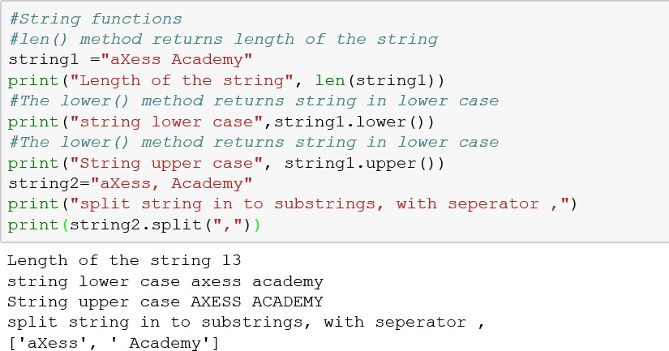
String built in functions

Slide 15
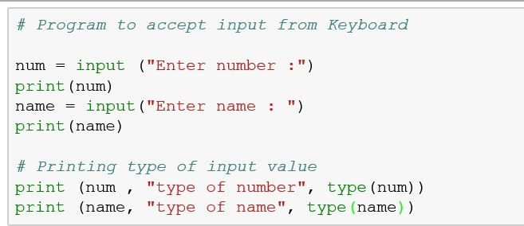
Taking Input from User with Implicit type conversion
Python provides inbuilt function to read the input from the keyboard

Slide 16
Operators
Operators are used to perform operations on variables and values. Python divides the operators in the following groups:
Arithmetic Operators Assignment Operators Comparison Operators Logical Operators Identity Operators Bitwise Operators
Membership OPythopn Esesenrtiaals
tors

Slide 17
Operators in Python
Arithmetic Operators
Arithmetic operators
Comparison Operators
are used with • Comparison operators are used to compare
numeric values to perform common values. It either returns True or False mathematical operations according to the condition.
Operator | Name | Examp le
+ | Addition | x + y
- | Subtraction | x - y
* | Multiplication | x * y
/ | Division | x / y
% | Modulus | x % y
** | Exponentiation | x ** y
Operator | Name | Example
== | Equal | x == y
!= | Not equal | x != y
> | Greater than | x > y
< | Less than | x < y
>= | Greater than or equal to | x >= y
<= | Less than or equal to | x <= y
17

Slide 18
Operators in Python
Logical Operators
Bitwise Operators
Logical operators are used to combine conditional statements:
Bitwise operators are used to compare
(binary) numbers:
Operat or | Name | Description
& | AND | Sets each bit to 1 if both bits are 1
| | OR | Sets each bit to 1 if one of two bits is 1
^ | XOR | Sets each bit to 1 if only one of two bits is 1
~ | NOT | Inverts all the bits
<< | Zero fill left shift | Shift left by pushing zeros in from the right and let the leftmost bits fall off
>> | Signed right shift | Shift right by pushing copies of the leftmost bit in from the left, and let the rightmost bits fall off
Operator | Description | Example
and | Returns True if both statements are true | x < 5 and x < 10
or | Returns True if one of the statements is true | x < 5 or x < 4
not | Reverse the result, returns False if the result is true | not(x < 5 and x < 10)
18

Slide 19
Operators in Python
Python Identity Operators
Logical operators are used to combine conditional statements:
Membership Operator
Membership operators are used to test if a sequence is presented in an object.
Opera tor | Description | Example
in | Returns True if a sequence with the specified value is present in the object | x in y
not in | Returns True if a sequence with the specified value is not present in the object | x not in y
Oper ator | Description | Example
is | Returns true if both variables are the same object | x is y
is not | Returns true if both variables are not the same object | x is not y
19

Slide 20
Assignment Operators
Assignment operators are used to assign values to variables:
Operator | Example | Same As
= | x = 5 | x = 5
+= | x += 3 | x = x + 3
-= | x -= 3 | x = x - 3
*= | x *= 3 | x = x * 3
/= | x /= 3 | x = x / 3
%= | x %= 3 | x = x % 3
**= | x **= 3 | x = x ** 3
&= | x &= 3 | x = x & 3
|= | x |= 3 | x = x | 3
^= | x ^= 3 | x = x ^ 3
>>= | x >>= 3 | x = x >> 3
<<= | x <<= 3 | x = x << 3

Slide 21
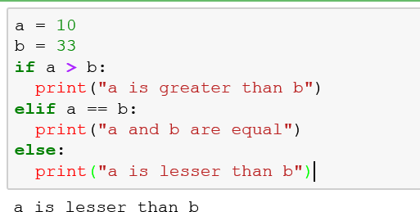
Conditional Statements - if, elif, else
If Statement is used for decision making. It will run the body of code only when IF statement is true.

Slide 22
Loops in python
Python has two primitive loop commands
  while loop
  for Loop
While loop can execute statements as long as the condition is true
For loop -This is less like the for keyword in other programming language, the for loop we can execute a set of statements, once for each item in a list, tuple, set etc.
For loop -This is less like the for keyword in other programming language, the for loop we can execute a set of statements, once for each item in a list, tuple, set etc.

Slide 23
Module 2
Collections – List, Tuple, Set, Dictionary

Slide 24
Data types in Python - Revisited
Number
List
Tuple
String
Set
Dictionary

Slide 25
Python Collections (Arrays)
There are four collection data types in the Python programming language:
  List is a collection which is ordered and changeable. Allows duplicate members.
  Tuple is a collection which is ordered and immutable. Allows duplicate members.
  Set is a collection which is unordered and unindexed. Does not allow duplicate members.
  Dictionary is a collection which is unordered, changeable and indexed. No duplicate
members.

Slide 26
Collection - List
List is a collection, which is ordered and changeable, in python list are created using square brackets
  Create List
  Access /Slice items
  Loop thru the list
  Append item
  Insert item
  Remove item
  Modify item
  Pop item
  Delete item
  Delete list
  List Concatenation
  Count()
  Index()
  Reverse()
  Sort()
  Clear()

Slide 27
List Methods
Method | Description
append() | Adds an element at the end of the list
clear() | Removes all the elements from the list
copy() | Returns a copy of the list
count() | Returns the number of elements with the specified value
index() | Returns the index of the first element with the specified value
insert() | Adds an element at the specified position
pop() | Removes the element at the specified position
remove() | Removes the item with the specified value
reverse() | Reverses the order of the list
sort() | Sorts the list

Slide 28
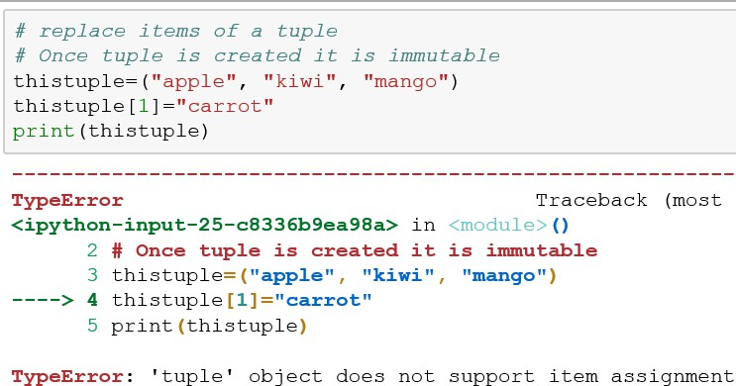
Tuple
A tuple is a collection which is ordered, and unchangeable, round brackets are used to create tuples.
Since tuple is immutable, we cannot modify, delete or add an item after the tuple created.
Create Tuple
Access items
Tuple Iterations
Count()
Index()

Slide 29
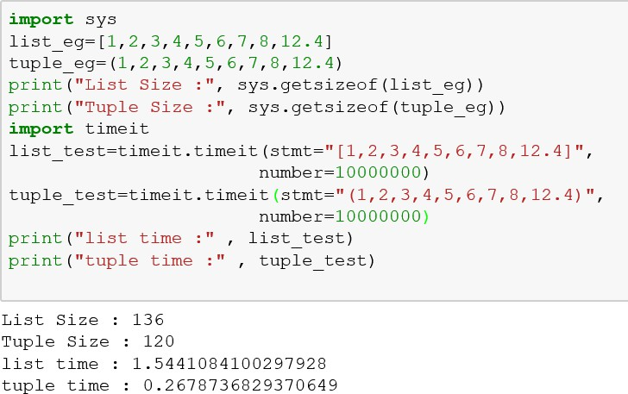
List and Tuple case study

Slide 30
Collection Set
A set is a collection which is unordered and unindexed. In Python sets are written with curly
brackets.
Create set
Acess items
Add items
Find length
Remove
item
discard
pop
Delete set
Union
intersection
issubset
Issuperset
update

Slide 31
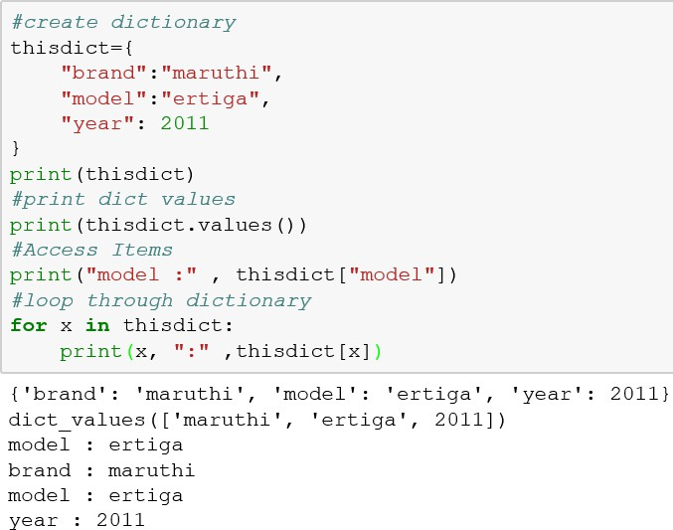
Dictionary
A dictionary is a collection which is unordered, changeable and indexed. In Python dictionaries are written with curly brackets, and they have keys and values.
create
Acess values
loop

Slide 32
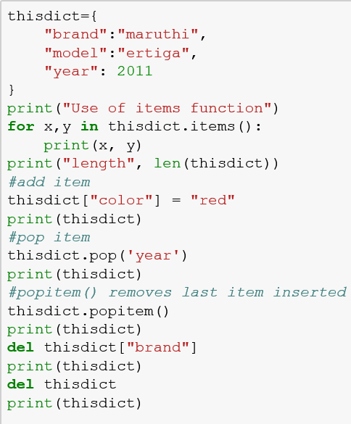
Dictionary continued
Loop using iems() function
Add item
Remove key value
pair
Pop last item
Delete key value pair
Delete dictionary

Slide 33
Module 3
File Operations

Slide 34
File Handling in Python
Python provides an inbuilt function for creating, writing and reading files
Python has several functions for creating, reading, updating, and deleting files
Build in function open() is used to open the files, the function returns a file object
Open function has two parameters : File name and Mode
There are four different modes while opening files:
"r" - Read - Default value. Opens a file for reading, error if the file does not exist "a" - Append - Opens a file for appending, creates the file if it does not exist "w" - Write - Opens a file for writing, creates the file if it does not exist
"x" - Create - Creates the specified file, returns an error if the file exists

Slide 35
Module 4
Functions

Slide 36






Functions
Functions are like a mini programs which performs a specific task. It is designed to perform a logical task and to reuse the code again for commonly used or repeatedly done task.
Function Definition:
def addition():
Should start with the def keyword
Ends with ()
and :
Followed by
<Function name>

Slide 37
Functions - Types
Syntax:
def <function name> ():
Statements
Sample Code:
def sample():
print(“Sample function call”) print(“Function called”)
sample()
Types of Function Call/ Argument Passing
Positional Arguments - The arguments passed are bound to the parameters in the same order
Keyword Arguments -
Argument passed with the keywords so that caller doesn’t have to remember the order while calling the function
- Parameter assumes a default value if a value is not passed for argument
and the function call. But once we have a default argument, all the arguments to its right must also have default values.
Default Parameters
Variable Length Argument - Not knowing how many arguments you will have to compare beforehand can
have varying number of arguments.

Slide 38
Module 5
Visualization - Matplotlib

Slide 39
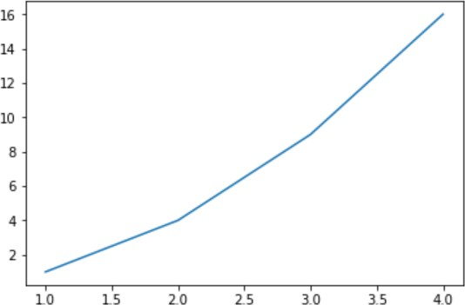
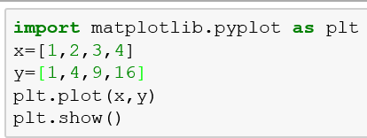
Matplotlib
Visualize data & Plotting library
Module used from mathplotlib is pyplot, which provides interface like MATLAB but uses python as its open source

Slide 40
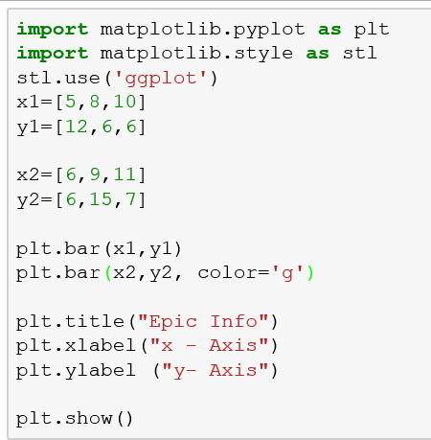
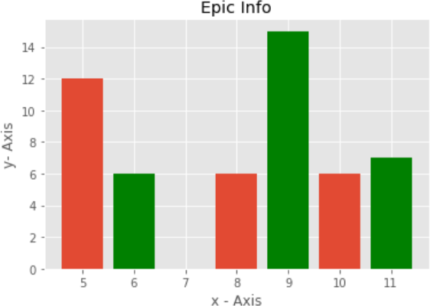
Bar Chart

Slide 41
Use Case Assignment

Slide 42

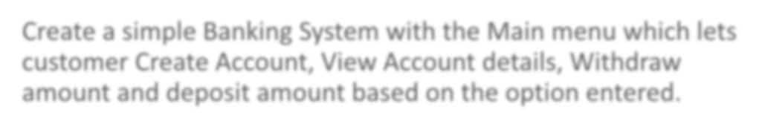

Problem Statement
Create a simple Banking System with the Main menu which lets customer Create Account, View Account details, Withdraw amount and deposit amount based on the option entered.

